Slide 1
SocioScope - Interim
Presentation
Ofir Fichman, Pavel Fadeev, Israel Peled

Slide 2
Project Review
Developing a real-time "Public Pulse" system that monitors Twitter to quantify public sentiment across 10 key socio-economic pillars.
Transitioned from manual annotation to an automated Synthetic Data Pipeline using LLMs to generate a high-quality, 10,000-sample dataset.
Applying advanced ABSA to the socio-economic domain (beyond standard product reviews) by outputting a 10-dimensional sentiment vector per tweet.

Slide 3
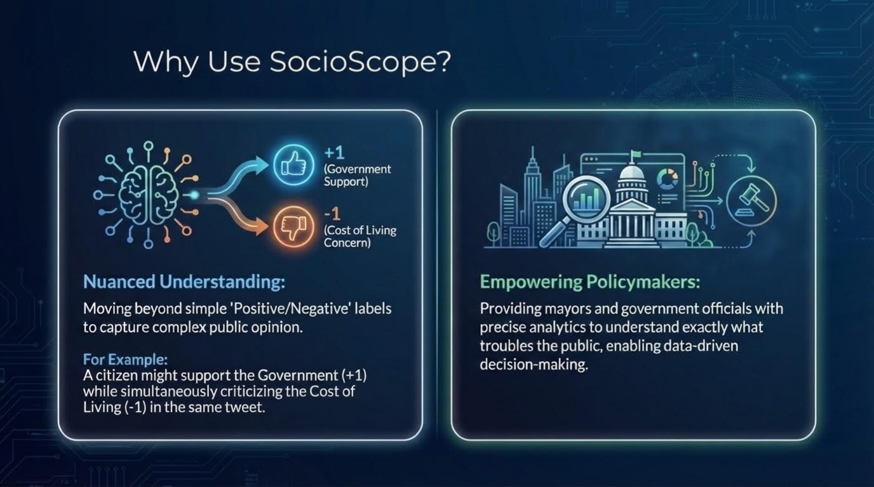

Slide 4
Previous work
Title / Year | The Task | Methods | Data | Results | Relation to SocioScope
MEMD-ABSA: A Multi-Element Multi-Domain Dataset for Aspect-Based Sentiment Analysis (2023) | Extracting the Aspect, Category, Opinion, and Sentiment even when they are not explicitly mentioned. | Generative Baselines (BART/T5) + Multi-Domain Training | 20,000 sentences across 5 domains (Books, Clothing, etc.) | Revealed that mining implicit aspects and opinions remains the biggest challenge in open-domain ABSA. | Directly validates our use of LLMs to infer implicit socio-economic sentiment from vague tweets.
Aspect-Based Sentiment Analysis Using BERT(2019) | Advanced Modeling: Using pre-trained BERT to identify aspects and sentiments | Fine-tuned BERT + Sentence-Pair Modeling | SemEval-2015 & SemEval-2016 | Outperformed previous SVM/CRF baselines | Justifies our use of BERT-like Transformers and "Supervised" synthetic labels.
Sentiment Analysis in the Era of LLMs: A Reality Check(2023) | Evaluating LLMs vs. Small Models | Comparing Zero-shot LLMs (ChatGPT) vs. Fine-tuned models (BERT) | 26 Standard sentiment datasets (IMDB, Twitter, Rest14) | Fine-tuned small models (like BERT) often outperform Zero-shot LLMs in specific tasks. | Supports our hypothesis that a fine-tuned BERT can surpass Gemma's zero-shot performance.

Slide 5
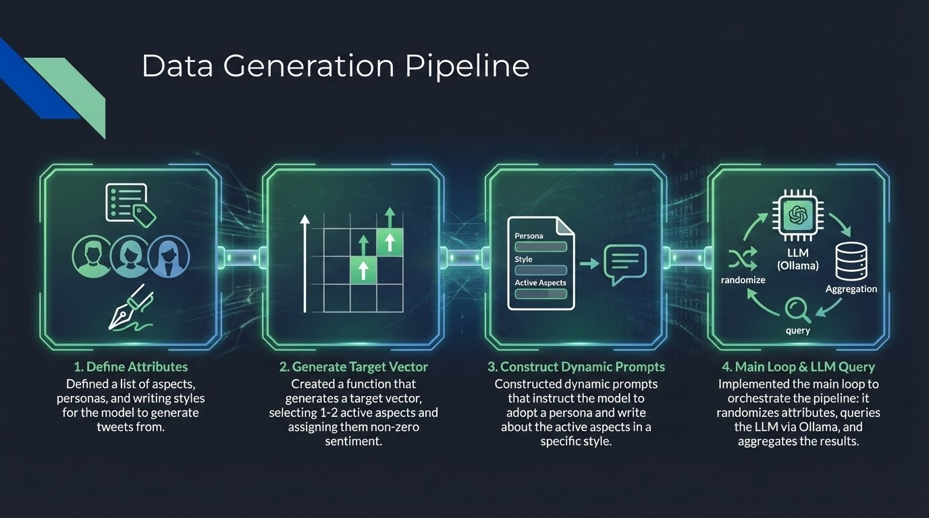

Slide 6
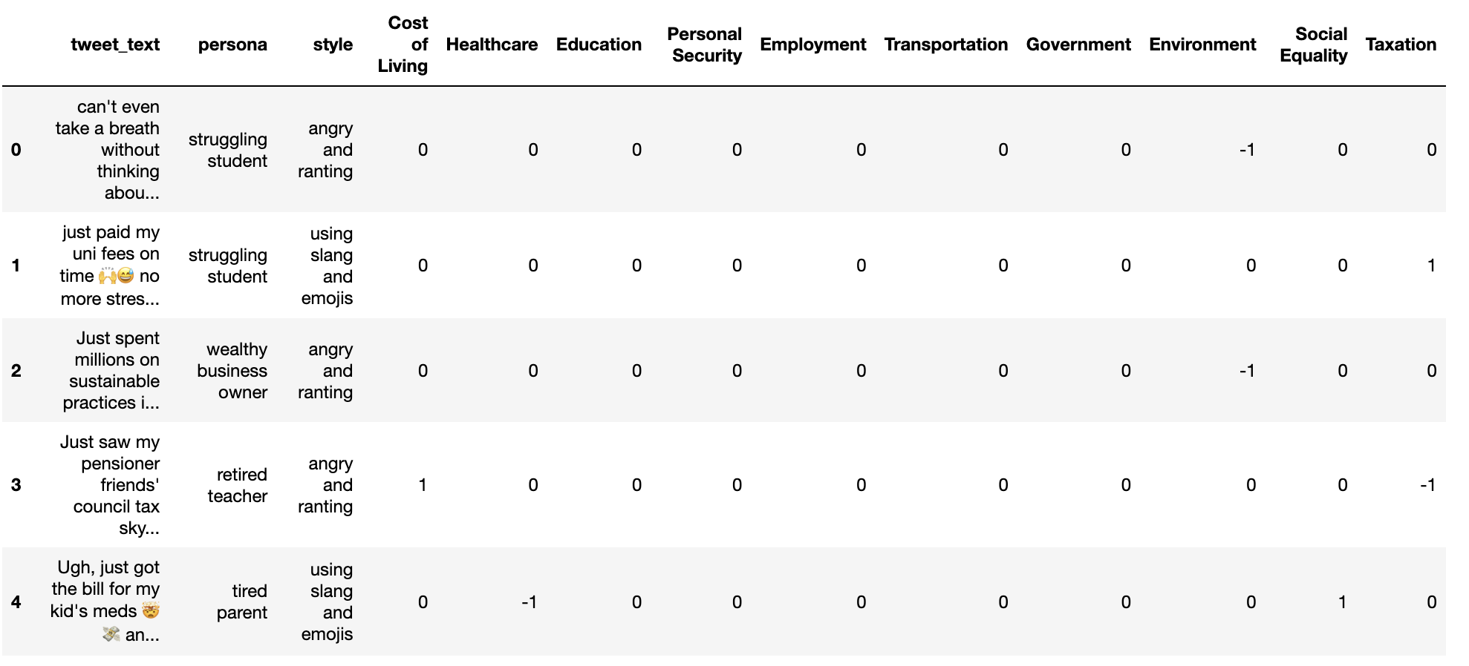
Dataset

Slide 7
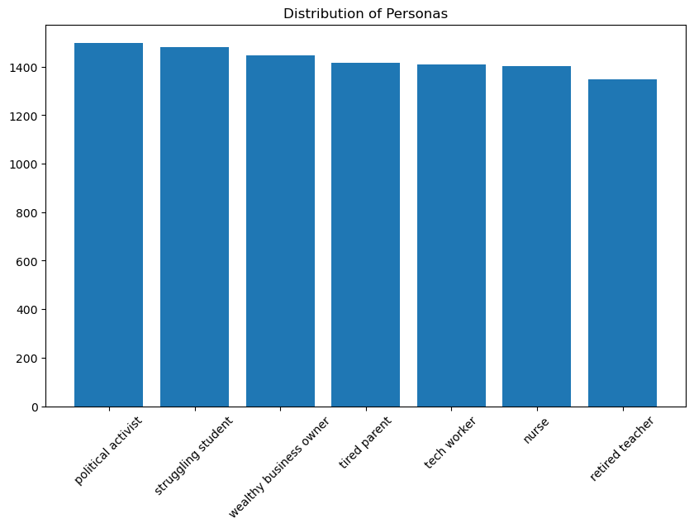
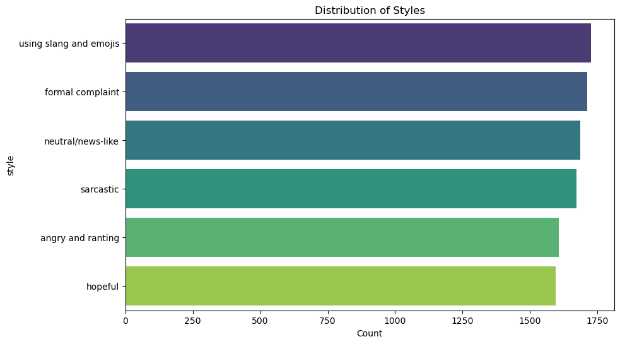
Distributions

Slide 8
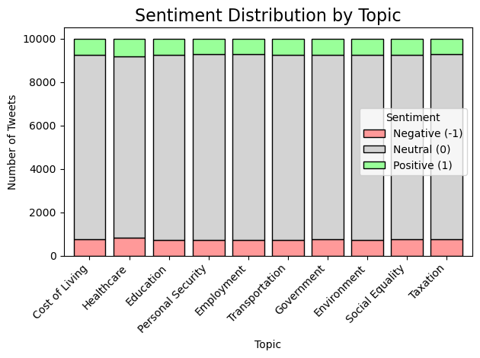

Slide 9
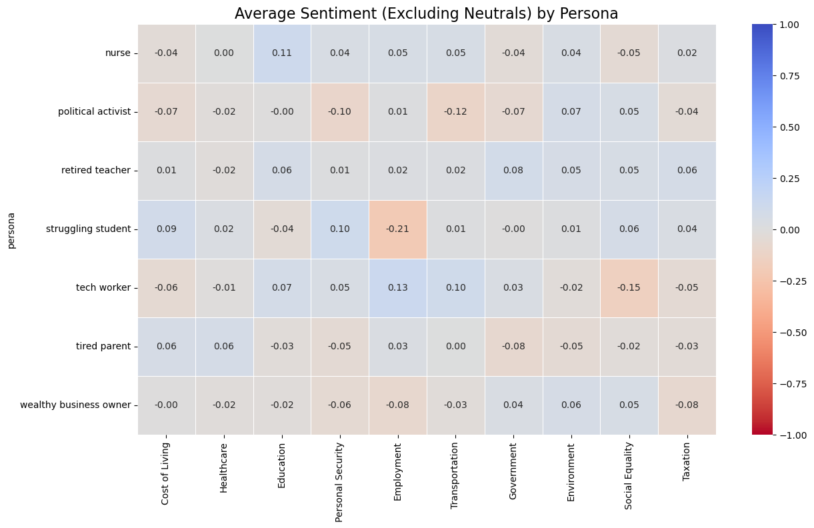

Slide 10
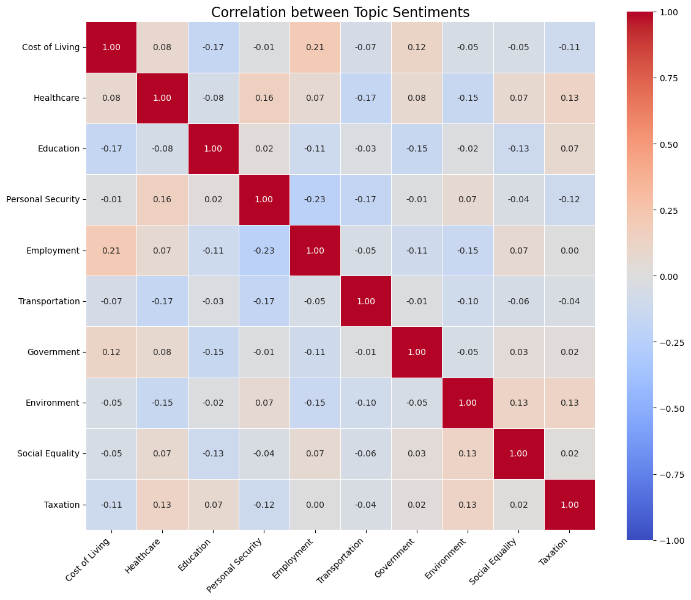

Slide 11
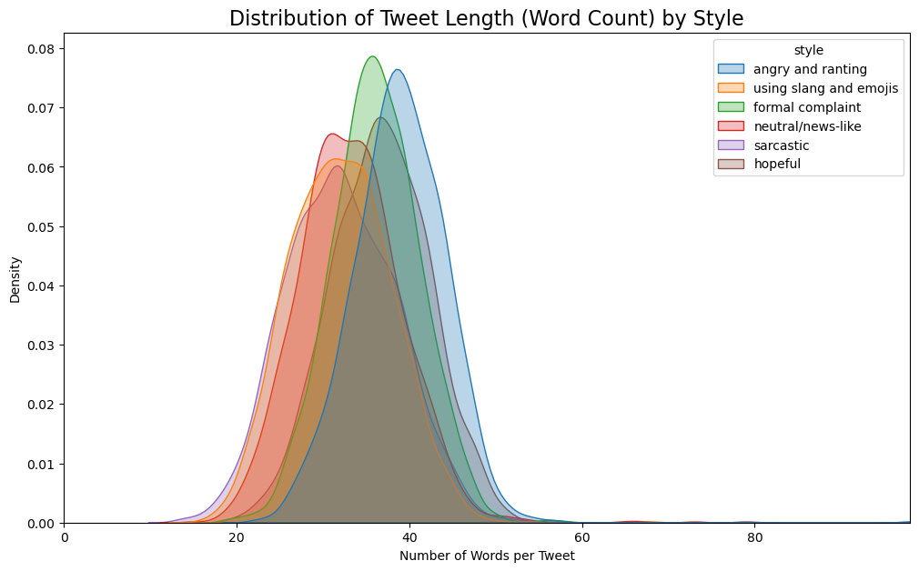

Slide 12
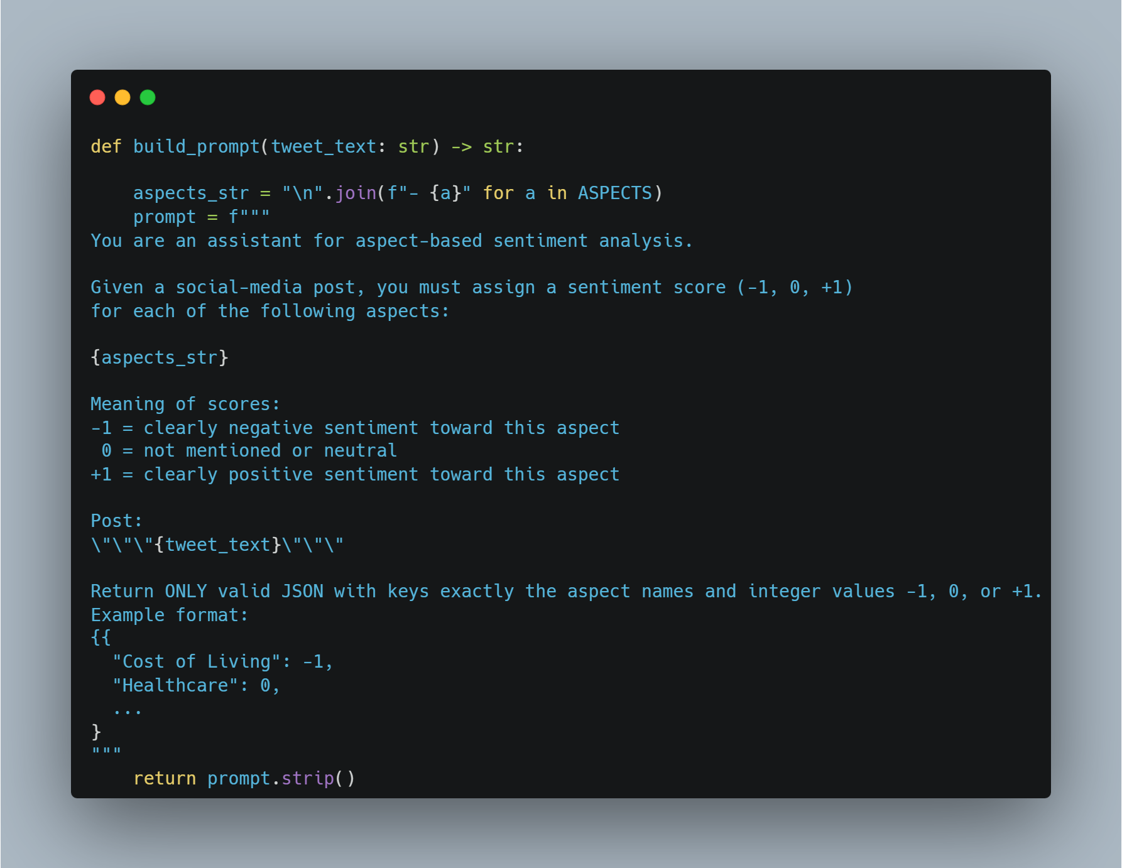
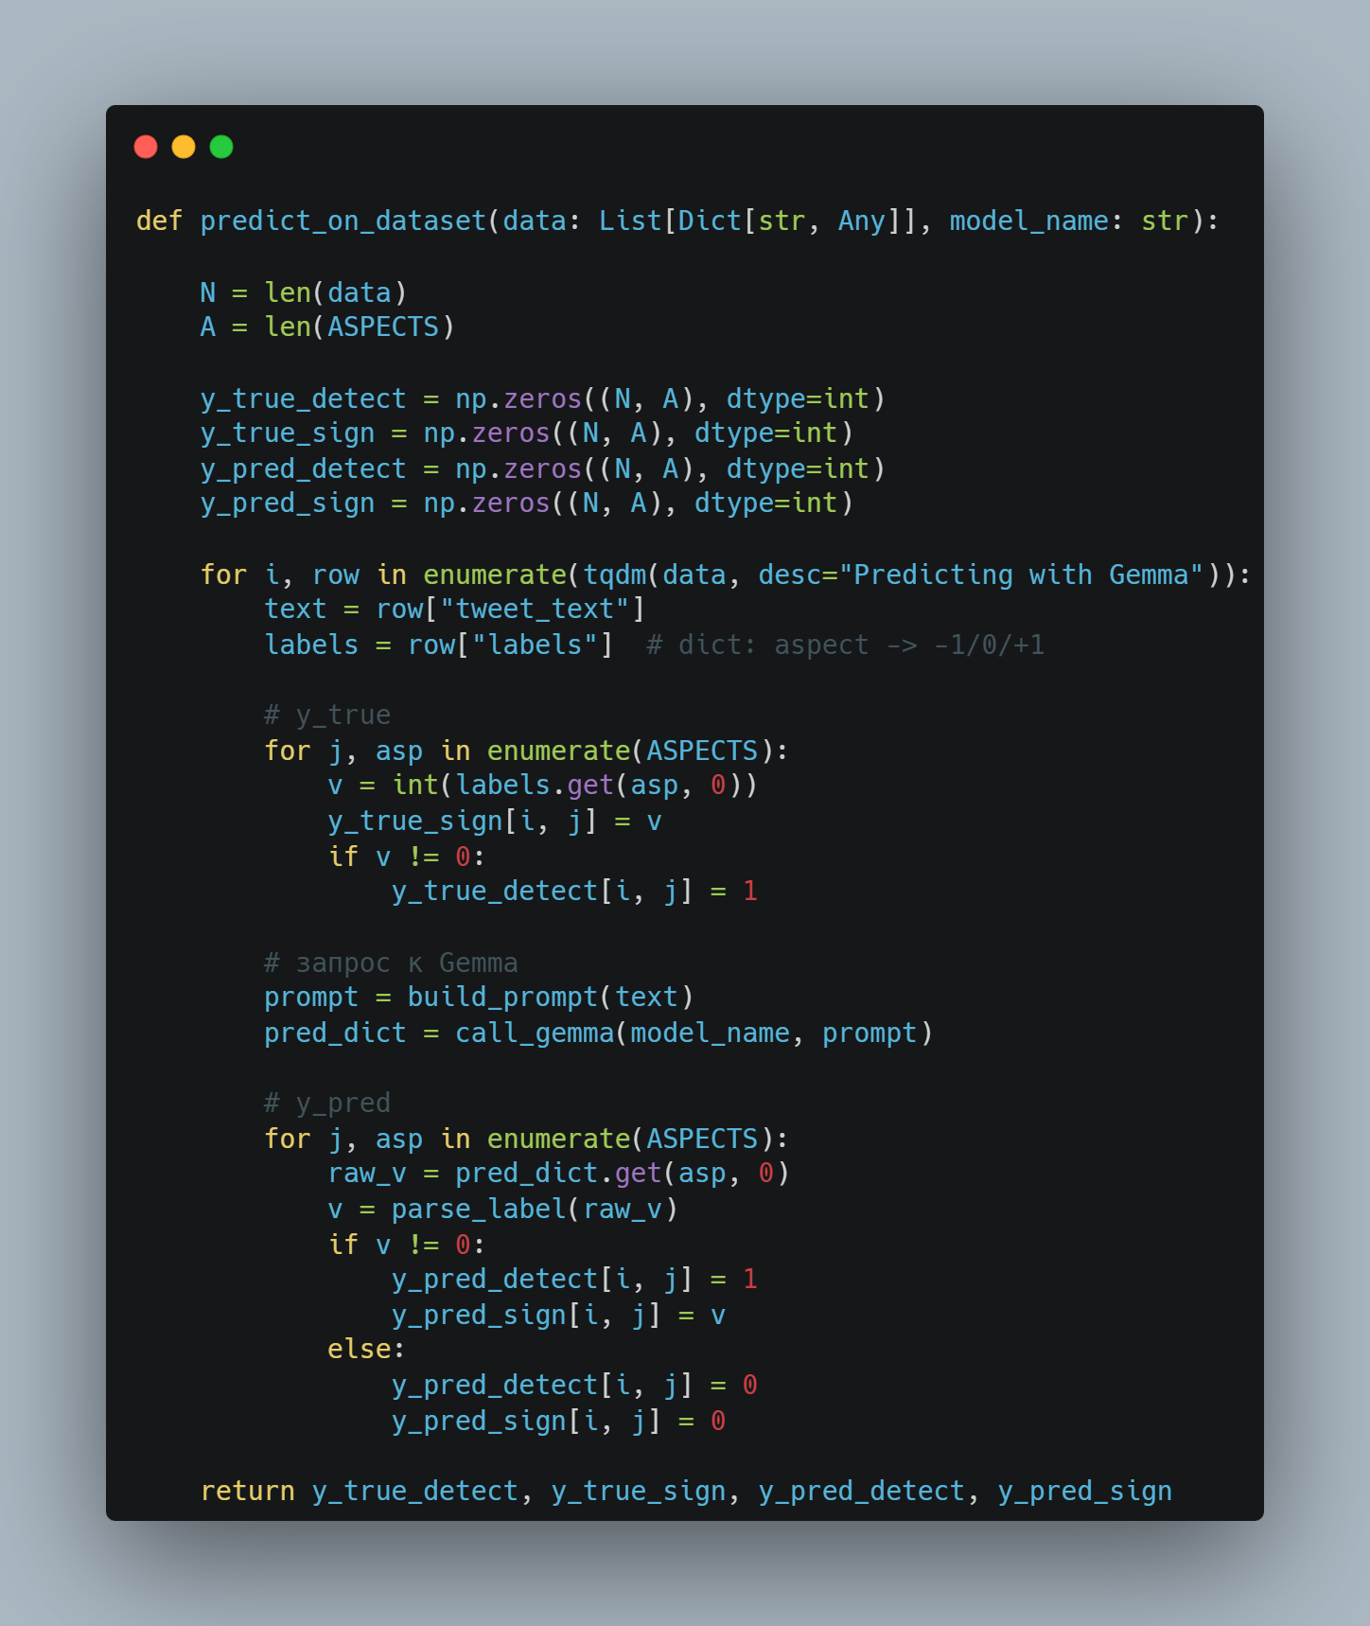
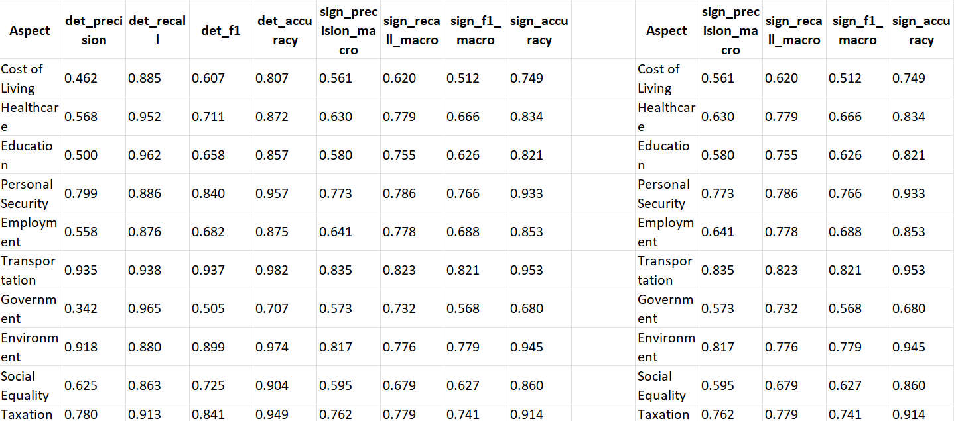
Baseline

Slide 13
